Slide 1

ФИТОСАНИТАРНЫЕ ПОСЛЕДСТВИЯ ВСТУПЛЕНИЯ РОССИИ В ВТО
А. Д. Орлинский
доктор биол. наук,
научный советник ЕОКЗР
Международная конференция «Россия в ВТО: воздействие на АПК» Москва, 27 июня 2012 года
Notes:
Ce modèle peut être utilisé comme fichier de démarrage pour présenter des supports de formation à un groupe.
Sections
Cliquez avec le bouton droit sur une diapositive pour ajouter des sections. Les sections permettent d’organiser les diapositives et facilitent la collaboration entre plusieurs auteurs.
Notes
Utilisez la section Notes pour les notes de présentation ou pour fournir des informations supplémentaires à l’audience. Affichez ces notes en mode Présentation pendant votre présentation.
N’oubliez pas de tenir compte de la taille de la police (critère important pour l’accessibilité, la visibilité, l’enregistrement vidéo et la production en ligne)
Couleurs coordonnées
Faites tout particulièrement attention aux diagrammes, graphiques et zones de texte.
Tenez compte du fait que les participants imprimeront la présentation en noir et blanc ou nuances de gris. Effectuez un test d’impression pour vérifier que vos couleurs s’impriment correctement en noir et blanc intégral et nuances de gris.
Graphiques, tableaux et diagrammes
Faites en sorte que votre présentation soit simple : utilisez des styles et des couleurs identiques qui ne soient pas gênants.
Ajoutez une étiquette à tous les graphiques et tableaux.

Slide 2
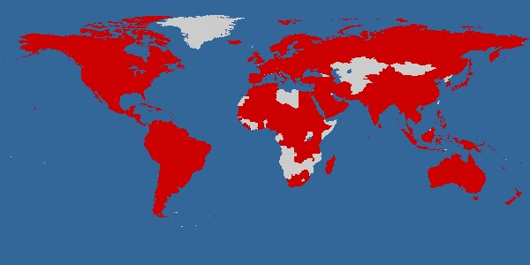
Международная конвенция по карантину и защите растений (МККЗР)
Российская Федерация – одна из 177 договаривающихся сторон МККЗР
Многосторонний договор о международном сотрудничестве в области карантина и защиты растений
Организация, разрабатывающая международные стандарты (МСФМ)
Штаб-квартира в Риме в здании ФАО
Notes:
The IPPC is an international agreement that binds contracting parties to the obligations of the convention. The IPPC also acts as a source of guidance by creating international standards and guidelines. As of October 2006, the IPPC involved 159 contracting parties.
Over 80% of the countries in the world are members, though initially actions to prevent transfer of pests between countries started as a very small idea.
1660: 1st legislation (Rouen, black stem rust)
1878: 1st international legislation (grapevine phylloxera)
1951: International Plant Protection Convention
1979: 1st revision of the IPPC
1991: 1st revision of the IPPC comes into force
1994: World Trade Organization Sanitary and Phytosanitary Agreement (WTO-SPS) adopted including recognition of the IPPC
1993: 1st IPPC Standard
1997: 2nd revision of the IPPC
1998: 1st ICPM meeting
2006: 2nd revision of the IPPC comes into force
2006: 1st CPM meeting
The IPPC does many things which we will learn about this morning and over the course of the next week. Probably its best known and arguably its most important role is in developing standards which can then be used by member countries to ensure that they are following the principles of the IPPC, protecting their own plant resources and also preventing the movement of plant pests.

Slide 3
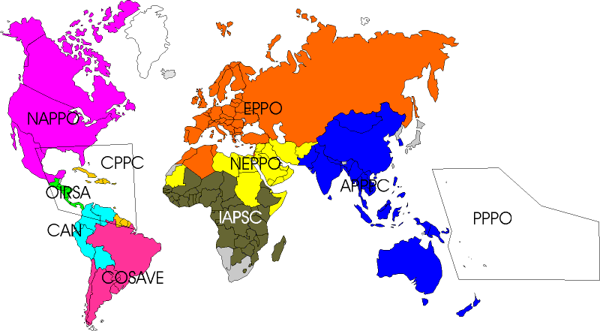

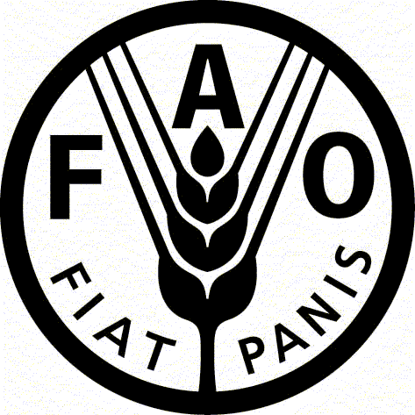
Региональные организации по карантину и защите растений

Slide 4
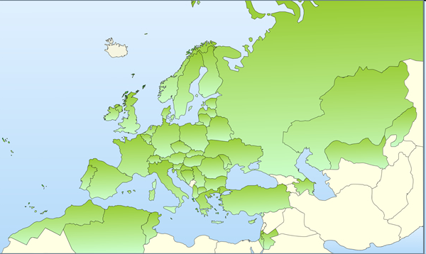
Европейская и Средиземно-морская организация по каран-тину и защите растений (ЕОКЗР)
Создана в 1951 году
Штаб-квартира в Париже
Российская Федерация является членом организации с 1957 года
В 2012 году
50 стран - членов
Notes:
Fournissez une brève vue d’ensemble de la présentation. Décrivez l’objectif principal de la présentation et expliquez son importance.
Présentez chaque sujet principal.
Pour fournir une feuille de route à votre audience, vous pouvez répéter cette diapositive de vue d’ensemble tout au long de la présentation afin de mettre en évidence le sujet suivant.

Slide 5
Пересмотр МККЗР в 1997 г.
Пересмотр был проведён для приведения МККЗР в соответствие с «Соглашением по применению санитарных и фитосанитарных мер» ВТО (Соглашением СФС)
В результате пересмотра МККЗР и Соглашение СФС базируются на общих международных принципах
Принципы подробно разъясняются в МСФМ № 1 «Фитосанитарные принципы карантина и защиты растений и применение фитосанитарных мер в международной торговле»
Notes:
The IPPC has eight key principles. These are the fundamental building blocks of the IPPC and are critical to its successful application in any individual member country. While the standards are guidelines, the principles are not. Understanding and adhering to the principles of the IPPC are critically important to its implementation in member countries.
The first principle is that of sovereignty. Every country has the sovereign right to use phytosanitary measures to prevent the introduction of quarantine pests and to determine its own level of acceptable risk whether that be very high, very low or somewhere in the middle. The remaining principles relate to any phytosanitary measures that are applied.
Measures should only be applied when necessary to prevent the introduction or spread of quarantine pests, and/or when the impact of regulated non-quarantine pests warrants it. Where applied, measures should be consistent with the pest risk, technically justified, and the least restrictive to address the risk. Where possible measures shall be based on international standards, guidelines and recommendations developed within the framework of the IPPC.
Additionally, the entire process should be transparent. Requirements, restrictions, prohibitions, and rationale for these measures and any modifications made to them, should be published and available upon request. The final key principle is that of dispute settlement. Disputes should be resolved where possible at the technical bilateral level.
We’ll here more about these principles this week as we discuss PRA in greater and greater detail, since implementing PRA in an NPPO is one of the most significant ways that a member country can ensure that it has respected the principles of the IPPC in the establishment of its phytosanitary measures and regulations.

Slide 6
Ключевые принципы МККЗР
суверенитет
необходимость
управляемый риск
минимальное воздействие
прозрачность
гармонизация
отсутствие дискриминации
техническое обоснование
сотрудничество
эквивалентность фитосанитарных мер
изменение
Notes:
The IPPC has eight key principles. These are the fundamental building blocks of the IPPC and are critical to its successful application in any individual member country. While the standards are guidelines, the principles are not. Understanding and adhering to the principles of the IPPC are critically important to its implementation in member countries.
The first principle is that of sovereignty. Every country has the sovereign right to use phytosanitary measures to prevent the introduction of quarantine pests and to determine its own level of acceptable risk whether that be very high, very low or somewhere in the middle. The remaining principles relate to any phytosanitary measures that are applied.
Measures should only be applied when necessary to prevent the introduction or spread of quarantine pests, and/or when the impact of regulated non-quarantine pests warrants it. Where applied, measures should be consistent with the pest risk, technically justified, and the least restrictive to address the risk. Where possible measures shall be based on international standards, guidelines and recommendations developed within the framework of the IPPC.
Additionally, the entire process should be transparent. Requirements, restrictions, prohibitions, and rationale for these measures and any modifications made to them, should be published and available upon request. The final key principle is that of dispute settlement. Disputes should be resolved where possible at the technical bilateral level.
We’ll here more about these principles this week as we discuss PRA in greater and greater detail, since implementing PRA in an NPPO is one of the most significant ways that a member country can ensure that it has respected the principles of the IPPC in the establishment of its phytosanitary measures and regulations.

Slide 7
Основной смысл принципов МККЗР
Страны имеют суверенное право применять фитосанитарные меры
Эти меры должны:
  применяться только в случае необходимости
  быть технически обоснованными с помощью анализа фитосанитарного риска (АФР)
  не быть более жёсткими, чем это необходимо для управления риском
  не быть дискриминирующими
  быть прозрачными
  регулярно пересматриваться
Меры, не соответствующие МСФМ и не обоснованные с помощью АФР, считаются техническими барьерами торговле
Notes:
The IPPC has eight key principles. These are the fundamental building blocks of the IPPC and are critical to its successful application in any individual member country. While the standards are guidelines, the principles are not. Understanding and adhering to the principles of the IPPC are critically important to its implementation in member countries.
The first principle is that of sovereignty. Every country has the sovereign right to use phytosanitary measures to prevent the introduction of quarantine pests and to determine its own level of acceptable risk whether that be very high, very low or somewhere in the middle. The remaining principles relate to any phytosanitary measures that are applied.
Measures should only be applied when necessary to prevent the introduction or spread of quarantine pests, and/or when the impact of regulated non-quarantine pests warrants it. Where applied, measures should be consistent with the pest risk, technically justified, and the least restrictive to address the risk. Where possible measures shall be based on international standards, guidelines and recommendations developed within the framework of the IPPC.
Additionally, the entire process should be transparent. Requirements, restrictions, prohibitions, and rationale for these measures and any modifications made to them, should be published and available upon request. The final key principle is that of dispute settlement. Disputes should be resolved where possible at the technical bilateral level.
We’ll here more about these principles this week as we discuss PRA in greater and greater detail, since implementing PRA in an NPPO is one of the most significant ways that a member country can ensure that it has respected the principles of the IPPC in the establishment of its phytosanitary measures and regulations.

Slide 8
Операционные принципы МККЗР
анализ фитосанитарного риска
создание перечней вредных организмов
признание свободных зон и зон низкой численности вредных организмов
официальная борьба с регулируемыми вредными организмами
системный подход
надзор за вредными организмами
оповещение о вредных организмах
фитосанитарная сертификация
Notes:
The IPPC has eight key principles. These are the fundamental building blocks of the IPPC and are critical to its successful application in any individual member country. While the standards are guidelines, the principles are not. Understanding and adhering to the principles of the IPPC are critically important to its implementation in member countries.
The first principle is that of sovereignty. Every country has the sovereign right to use phytosanitary measures to prevent the introduction of quarantine pests and to determine its own level of acceptable risk whether that be very high, very low or somewhere in the middle. The remaining principles relate to any phytosanitary measures that are applied.
Measures should only be applied when necessary to prevent the introduction or spread of quarantine pests, and/or when the impact of regulated non-quarantine pests warrants it. Where applied, measures should be consistent with the pest risk, technically justified, and the least restrictive to address the risk. Where possible measures shall be based on international standards, guidelines and recommendations developed within the framework of the IPPC.
Additionally, the entire process should be transparent. Requirements, restrictions, prohibitions, and rationale for these measures and any modifications made to them, should be published and available upon request. The final key principle is that of dispute settlement. Disputes should be resolved where possible at the technical bilateral level.
We’ll here more about these principles this week as we discuss PRA in greater and greater detail, since implementing PRA in an NPPO is one of the most significant ways that a member country can ensure that it has respected the principles of the IPPC in the establishment of its phytosanitary measures and regulations.

Slide 9
Операционные принципы МККЗР (продолжение)
фитосанитарная целостность и безопасность грузов
срочное действие
экстренные меры
создание Национальной организации по карантину и защите растений
урегулирование споров
избежание неоправданных задержек
нотификация о несоответствии
обмен информацией
техническое содействие
Notes:
The IPPC has eight key principles. These are the fundamental building blocks of the IPPC and are critical to its successful application in any individual member country. While the standards are guidelines, the principles are not. Understanding and adhering to the principles of the IPPC are critically important to its implementation in member countries.
The first principle is that of sovereignty. Every country has the sovereign right to use phytosanitary measures to prevent the introduction of quarantine pests and to determine its own level of acceptable risk whether that be very high, very low or somewhere in the middle. The remaining principles relate to any phytosanitary measures that are applied.
Measures should only be applied when necessary to prevent the introduction or spread of quarantine pests, and/or when the impact of regulated non-quarantine pests warrants it. Where applied, measures should be consistent with the pest risk, technically justified, and the least restrictive to address the risk. Where possible measures shall be based on international standards, guidelines and recommendations developed within the framework of the IPPC.
Additionally, the entire process should be transparent. Requirements, restrictions, prohibitions, and rationale for these measures and any modifications made to them, should be published and available upon request. The final key principle is that of dispute settlement. Disputes should be resolved where possible at the technical bilateral level.
We’ll here more about these principles this week as we discuss PRA in greater and greater detail, since implementing PRA in an NPPO is one of the most significant ways that a member country can ensure that it has respected the principles of the IPPC in the establishment of its phytosanitary measures and regulations.

Slide 10
Категории вредных для растений организмов
ВРЕДНЫЕ
ОРГАНИЗМЫ
РЕГУЛИРУЕМЫЕ
НЕРЕГУЛИРУЕМЫЕ
КАРАНТИННЫЕ
РНКВО
ОТСУТСТВУЮЩИЕ
ОГРАНИЧЕННО
РАСПРОСТРАНЕННЫЕ

Slide 11
Национальная организация по карантину и защите растений (НОКЗР)
Каждая договаривающаяся сторона МККЗР должна создать (назначить) свою официальную НОКЗР
В РФ полномочиями НОКЗР наделён Россельхозназдор
В МККЗР описаны функции НОКЗР, выполнение которых преследуется с двумя основными целями:
  обеспечение фитосанитарной безопасности территории своей страны
  обеспечение фитосанитарной безопасности экспортируемых грузов
Notes:
The IPPC has eight key principles. These are the fundamental building blocks of the IPPC and are critical to its successful application in any individual member country. While the standards are guidelines, the principles are not. Understanding and adhering to the principles of the IPPC are critically important to its implementation in member countries.
The first principle is that of sovereignty. Every country has the sovereign right to use phytosanitary measures to prevent the introduction of quarantine pests and to determine its own level of acceptable risk whether that be very high, very low or somewhere in the middle. The remaining principles relate to any phytosanitary measures that are applied.
Measures should only be applied when necessary to prevent the introduction or spread of quarantine pests, and/or when the impact of regulated non-quarantine pests warrants it. Where applied, measures should be consistent with the pest risk, technically justified, and the least restrictive to address the risk. Where possible measures shall be based on international standards, guidelines and recommendations developed within the framework of the IPPC.
Additionally, the entire process should be transparent. Requirements, restrictions, prohibitions, and rationale for these measures and any modifications made to them, should be published and available upon request. The final key principle is that of dispute settlement. Disputes should be resolved where possible at the technical bilateral level.
We’ll here more about these principles this week as we discuss PRA in greater and greater detail, since implementing PRA in an NPPO is one of the most significant ways that a member country can ensure that it has respected the principles of the IPPC in the establishment of its phytosanitary measures and regulations.

Slide 12
РОЛЬ НОКЗР В НАЦИОНАЛЬНОЙ ФИТОСАНИТАРНОЙ СИСТЕМЕ И БЕЗОПАСНОЙ ТОРГОВЛЕ
ВТО, СФС, ФАО, МККЗР, ЕОКЗР,
ОБРАЗОВАНИЕ, ПОДГОТОВКА КАДРОВ
ГОСУДАРСТВЕННЫЙ СЕКТОР
Мин. ТОРГОВЛИ
МИД, МЮ
МЗ, МЭПР
МФ, МЭ,
ПРОВЕРКА ИМПОРТА
НОКЗР
СЕРТИФИКАЦИЯ ЭКСПОРТА
ТАМОЖНЯ
ПУНКТЫ ВЫВОЗА
УЛУЧШЕНИЕ ФИТОСОСТОЯНИЯ
ЦЕПЬ КОММЕРЦИАЛИЗАЦИИ РАСТЕНИЙ И РАСТ. ПРОДУКТОВ
ЭКСПОРТ, ДОСТУП К РЫНКАМ
ИМПОРТ
ПРОИЗВОДСТВО
ПЕРЕРАБОТКА, ТРАНСПОРТИРОВКА
ТОРГОВЛЯ
ПРОИЗВОДИТЕЛИ
ПОТРЕБИТЕЛИ
ПЕРЕРАБОТЧИКИ И ПЕРЕВОЗЧИКИ
ИМПОРТЕРЫ И ЭКСПОРТЕРЫ
НАЦИОНАЛЬНАЯ ЭКОНОМИЧЕСКАЯ ПОЛИТИКА
СВОБОДНАЯ ТОРГОВЛЯ
ИССЛЕДОВАНИЯ, НАУКА
ЧАСТНЫЙ СЕКТОР

Slide 13
Основные фитосанитарные последствия вступления РФ в ВТО
Российская Федерация должна будет наиболее полным образом следовать принципам МККЗР и Соглашения СФС, а также международным (МСФМ) и региональным (ЕОКЗР) фитосанитарным стандартам
Расширятся права требовать от стран – торговых партнёров выполнять фитосанитарные правила Российской Федерации
  Пример с требованиями Директивы Евросоюза 2000/29/ЕС в отношении «неевропейских» видов Scolytidae (короедов), Pissodes (смолёвок) и Monochamus (усачей)
Notes:
The IPPC has eight key principles. These are the fundamental building blocks of the IPPC and are critical to its successful application in any individual member country. While the standards are guidelines, the principles are not. Understanding and adhering to the principles of the IPPC are critically important to its implementation in member countries.
The first principle is that of sovereignty. Every country has the sovereign right to use phytosanitary measures to prevent the introduction of quarantine pests and to determine its own level of acceptable risk whether that be very high, very low or somewhere in the middle. The remaining principles relate to any phytosanitary measures that are applied.
Measures should only be applied when necessary to prevent the introduction or spread of quarantine pests, and/or when the impact of regulated non-quarantine pests warrants it. Where applied, measures should be consistent with the pest risk, technically justified, and the least restrictive to address the risk. Where possible measures shall be based on international standards, guidelines and recommendations developed within the framework of the IPPC.
Additionally, the entire process should be transparent. Requirements, restrictions, prohibitions, and rationale for these measures and any modifications made to them, should be published and available upon request. The final key principle is that of dispute settlement. Disputes should be resolved where possible at the technical bilateral level.
We’ll here more about these principles this week as we discuss PRA in greater and greater detail, since implementing PRA in an NPPO is one of the most significant ways that a member country can ensure that it has respected the principles of the IPPC in the establishment of its phytosanitary measures and regulations.

Slide 14
Рекомендации
гармонизировать фитосанитарное законодательство Российской Федерации с МККЗР и международными (МСФМ) и региональными (разработанными ЕОКЗР) фитосанитарными стандартами,
наладить эффективную систему проведения АФР в соответствии с международными и региональными (разработанными ЕОКЗР) стандартами в качестве технического обоснования применяемых мер
Notes:
The IPPC has eight key principles. These are the fundamental building blocks of the IPPC and are critical to its successful application in any individual member country. While the standards are guidelines, the principles are not. Understanding and adhering to the principles of the IPPC are critically important to its implementation in member countries.
The first principle is that of sovereignty. Every country has the sovereign right to use phytosanitary measures to prevent the introduction of quarantine pests and to determine its own level of acceptable risk whether that be very high, very low or somewhere in the middle. The remaining principles relate to any phytosanitary measures that are applied.
Measures should only be applied when necessary to prevent the introduction or spread of quarantine pests, and/or when the impact of regulated non-quarantine pests warrants it. Where applied, measures should be consistent with the pest risk, technically justified, and the least restrictive to address the risk. Where possible measures shall be based on international standards, guidelines and recommendations developed within the framework of the IPPC.
Additionally, the entire process should be transparent. Requirements, restrictions, prohibitions, and rationale for these measures and any modifications made to them, should be published and available upon request. The final key principle is that of dispute settlement. Disputes should be resolved where possible at the technical bilateral level.
We’ll here more about these principles this week as we discuss PRA in greater and greater detail, since implementing PRA in an NPPO is one of the most significant ways that a member country can ensure that it has respected the principles of the IPPC in the establishment of its phytosanitary measures and regulations.

Slide 15
Рекомендации
(продолжение)
усилить участие российских экспертов в деятельности МККЗР и ЕОКЗР, особенности в области разработки новых международных и региональных фитосанитарных стандартов
провести кампанию по оповещению общественности (в особенности всех, кто вовлечён в производство, перевозку, хранение, экспорт и импорт растений и растительных продуктов) о функциях и деятельности НОКЗР Российской Федерации по обеспечению фитосанитар-ной безопасности импорта и экспорта растений и растительных продуктов
Notes:
The IPPC has eight key principles. These are the fundamental building blocks of the IPPC and are critical to its successful application in any individual member country. While the standards are guidelines, the principles are not. Understanding and adhering to the principles of the IPPC are critically important to its implementation in member countries.
The first principle is that of sovereignty. Every country has the sovereign right to use phytosanitary measures to prevent the introduction of quarantine pests and to determine its own level of acceptable risk whether that be very high, very low or somewhere in the middle. The remaining principles relate to any phytosanitary measures that are applied.
Measures should only be applied when necessary to prevent the introduction or spread of quarantine pests, and/or when the impact of regulated non-quarantine pests warrants it. Where applied, measures should be consistent with the pest risk, technically justified, and the least restrictive to address the risk. Where possible measures shall be based on international standards, guidelines and recommendations developed within the framework of the IPPC.
Additionally, the entire process should be transparent. Requirements, restrictions, prohibitions, and rationale for these measures and any modifications made to them, should be published and available upon request. The final key principle is that of dispute settlement. Disputes should be resolved where possible at the technical bilateral level.
We’ll here more about these principles this week as we discuss PRA in greater and greater detail, since implementing PRA in an NPPO is one of the most significant ways that a member country can ensure that it has respected the principles of the IPPC in the establishment of its phytosanitary measures and regulations.

Slide 16
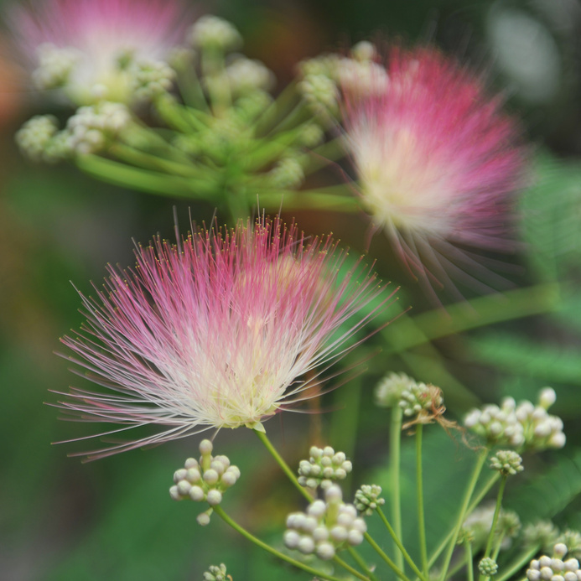
Спасибо за внимание
60-летний юбилей ЕОКЗР
Notes:
16

